Slide 1
SDLC Models

Slide 2
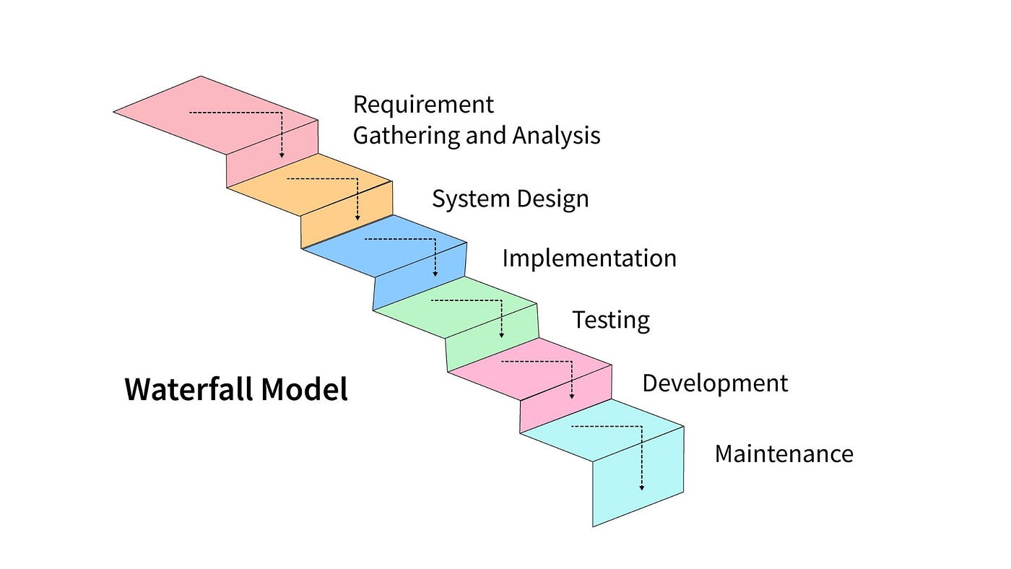
Waterfall Model
The Waterfall model is a sequential software development process model that follows a linear and sequential approach.
It divides the development process into distinct phases, with each phase being completed before the next one begins.
The Waterfall model offers a structured approach to software development and is suitable for projects with well-defined and stable requirements, it may not be the best choice for projects where requirements are likely to change or for highly complex projects.
Deployment

Slide 3
Phases of the Waterfall Model
Requirements Gathering: In this phase, all requirements for the software are gathered and documented.
System Design: Based on the requirements, the system architecture and design are created.
Implementation: The actual coding and development of the software take place in this phase.
Testing: After development, the software undergoes testing to ensure it meets the specified requirements.
Deployment: Once testing is successful, the software is deployed to the production environment.
Maintenance: This phase involves ongoing maintenance and support for the software.

Slide 4
Advantages of the Waterfall Model
Simplicity: The model is easy to understand and use, making it suitable for small to medium-sized projects.
Structured Approach: The sequential nature of the model provides a structured approach to software development, making it easier to manage and track progress.
Clear Milestones: Each phase has clear deliverables and milestones, which helps in better project management and planning.
Documentation: Since requirements are gathered upfront and each phase has its documentation, it facilitates better documentation throughout the development process.
Easy to Manage: The linear nature of the model makes it easy to manage as each phase has specific goals and objectives.

Slide 5
Disadvantages of the Waterfall Model
Inflexibility: Once a phase is completed, it's challenging to go back and make changes without affecting subsequent phases.
Risk of Requirement Changes: Since all requirements are gathered upfront, any changes in requirements later in the project can be costly and time-consuming to implement.
Late Testing: Testing is done after the development phase, which means that any defects found during testing may require significant rework, leading to delays and increased costs.
Limited Customer Interaction: There's minimal customer involvement until the end of the project, which may result in the final product not meeting customer expectations.
Not Suitable for Complex Projects: The Waterfall model may not be suitable for large or complex projects where requirements are likely to change, as it doesn't easily accommodate changes once the development process has started.

Slide 6
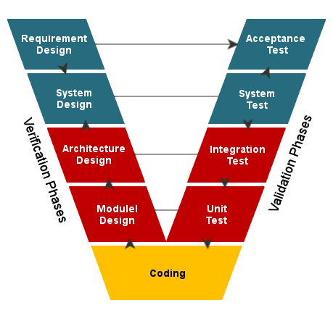
V-Model
The V-Model, also known as the Verification and Validation model, is an extension of the traditional Waterfall model.
It emphasizes the relationship between each phase of the development lifecycle and its corresponding testing phase.
The V-Model offers benefits such as early defect detection and clear traceability between requirements and tests, it may not be the best choice for projects that require flexibility or frequent changes in requirements.

Slide 7
Advantages of the V-Model
Emphasis on Testing: The V-Model emphasizes testing throughout the development lifecycle, ensuring that defects are identified and addressed early.
Clear Traceability: There's a clear relationship between each phase of development and its corresponding testing phase, making it easy to trace requirements to tests.
Early Detection of Defects: Testing is integrated into each phase, allowing defects to be identified and fixed early in the development process.
Reduced Risk: By identifying and addressing defects early, the V-Model helps reduce the risk of project failure or delays.
Structured Approach: Like the Waterfall model, the V-Model provides a structured approach to software development, making it easier to manage and track progress.

Slide 8
Disadvantages of the V-Model
Inflexibility: Similar to the Waterfall model, the V-Model can be inflexible and may not easily accommodate changes in requirements or design once the development process has started.
Complexity: The V-Model can be more complex than other development models due to the emphasis on testing throughout the lifecycle.
Limited Customer Interaction: There's minimal customer involvement until the end of the project, which may result in the final product not meeting customer expectations.
Dependency on Documentation: The success of the V-Model relies heavily on comprehensive documentation, which can be time-consuming and may not always reflect the current state of the project.
Not Suitable for Agile Projects: The V-Model may not be suitable for Agile projects or projects where requirements are likely to change frequently, as it follows a sequential and structured approach to development.

Slide 9
Agile Scrum Model
The Agile Scrum model is an iterative and incremental software development methodology that emphasizes collaboration, flexibility, and customer feedback.
It's a subset of Agile methodologies and is widely used in various industries.
Agile Scrum is highly beneficial for projects that require flexibility, frequent customer collaboration, and the ability to adapt to change. However, it may not be suitable for all projects, and its success depends on the capabilities of the team and the alignment of the project with Agile principles.

Slide 10
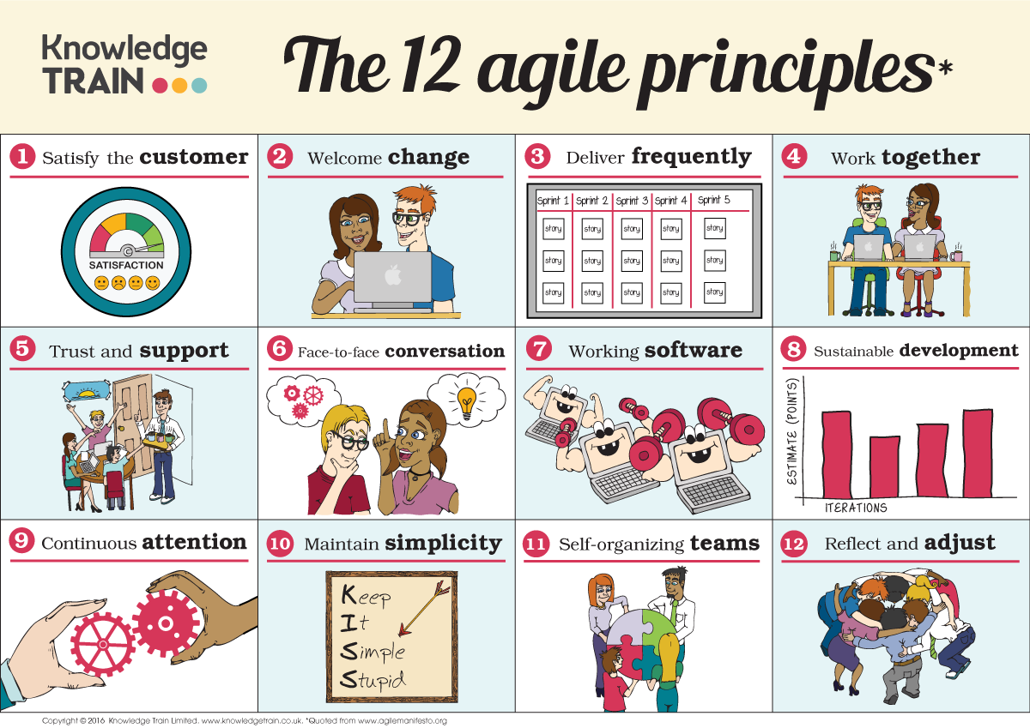
Agile Principles
Individuals and interactions over processes and tools.
Working software over comprehensive documentation.
Customer collaboration over contract negotiation.
Responding to change over following a plan.

Slide 11
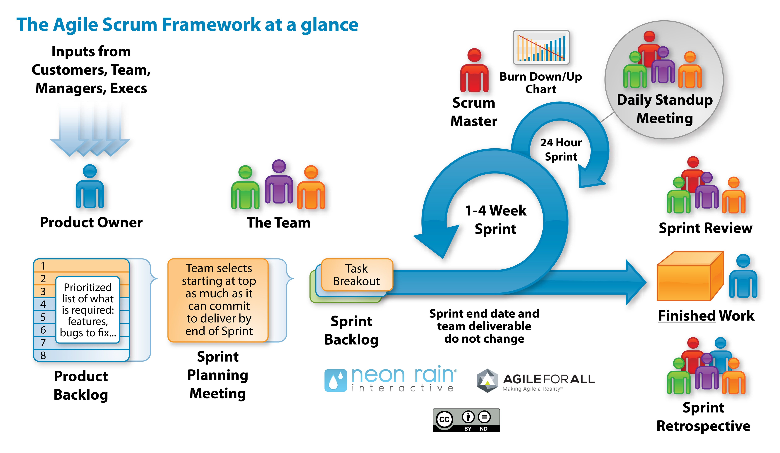
Scrum Framework
Roles: Scrum Master, Product Owner, and Development Team.
Artifacts: Product Backlog, Sprint Backlog, and Increment.
Events: Sprint Planning, Daily Stand-ups, Sprint Review, and Sprint Retrospective.

Slide 12
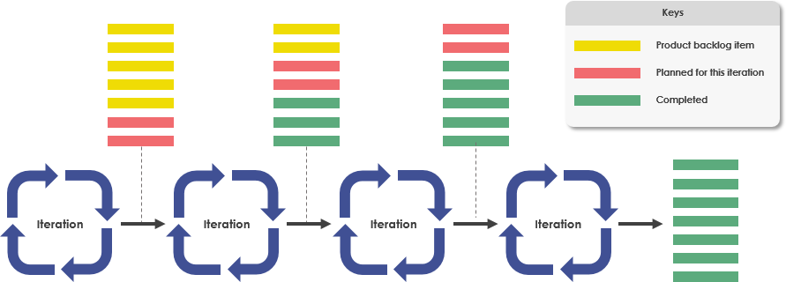
Iterative and Incremental Development
Projects are divided into small iterations called Sprints, typically 1-4 weeks long.
Each Sprint results in a potentially shippable product increment.

Slide 13
Advantages of Agile Scrum
Flexibility: Agile Scrum allows for changes and adjustments throughout the development process, making it suitable for projects with evolving requirements.
Customer Satisfaction: Continuous customer involvement and feedback ensure that the final product meets customer expectations and requirements.
Early Delivery: Incremental delivery of working software enables early validation and feedback from stakeholders.
Transparency: Daily stand-ups, regular reviews, and retrospectives promote transparency and collaboration within the team.
Adaptability: Teams can adapt to changes quickly, ensuring that the project stays on track and delivers value even in the face of uncertainty.

Slide 14
Disadvantages of Agile Scrum
Requires Experienced Team: Agile Scrum requires a highly skilled and self-organized team capable of making decisions and working collaboratively.
Lack of Predictability: The iterative and incremental nature of Agile Scrum may make it challenging to predict the final delivery date or the exact scope of the project.
Emphasis on Communication: Heavy reliance on communication and collaboration may pose challenges for distributed teams or teams with members in different time zones.
Documentation: Agile Scrum prioritizes working software over comprehensive documentation, which may lead to documentation being overlooked or not updated adequately.
Not Suitable for All Projects: Agile Scrum may not be suitable for projects with strict regulatory requirements or fixed scope, as it prioritizes flexibility and adaptability over rigid planning and documentation.

